Slide 1
New Student Orientation
General Recording Slides
English Translation
Notes:
Welcome to CGCC’s New Student Orientation! These are the general recording slides, meaning the information we will be sharing is not date or term specific. If you would like to attend a live orientation specific to your term, check the New Student Orientation webpage or cgcc.edu/nso for upcoming dates and registration information.

Slide 2
If you have not already…
Watch the introduction video from CGCC President, Dr. Lawson.
Open up a copy of these slides (available in English or Spanish) in another tab to follow along and open up the live links!
Notes:
If you have not already, watch the introduction video of CGCC President, Dr. Lawson. You can access this video by visiting the NSO webpage.
Before getting started, it may also be helpful to open up a copy of these slides in another tab to follow along and open up the live links, which are embedded in this presentation in lime text. This slideshow is available on the NSO webpage in English and Spanish translations.

Slide 3
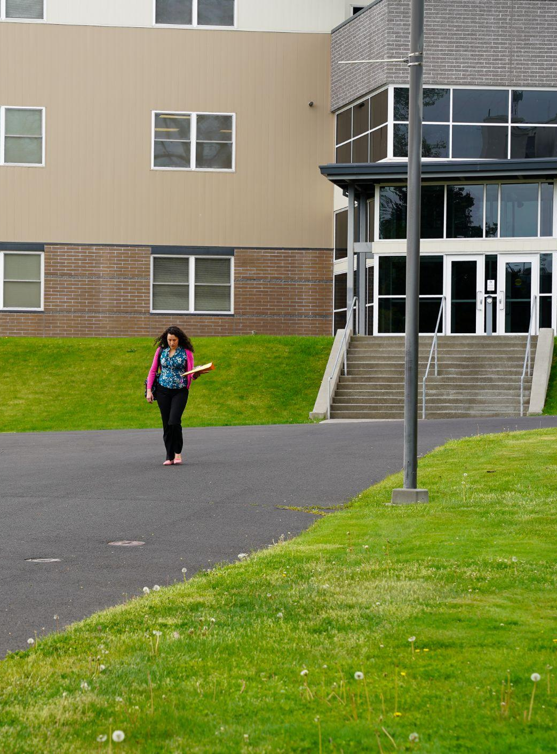
MyCGCC DeepDive
Goal: Learn MyCGCC, which contains tools students need to be successful at CGCC. This activity will go over:
My CGCC: Student Portal
CGCC Gmail
Moodle: Online Learning Platform
Slingshot: Book & Material Purchase
Global: Financial Aid Portal

Slide 4
Deepdive: MyCGCC & Gmail
My CGCC login:
Go to my.cgcc.edu
Click on “Student Portal Homepage”
Enter your CGCC email address and provided password
CGCC Gmail
Any and all emails from the college and instructors will be sent to your CGCC student gmail only.
Log into your MyCGCC
Click the “Moodle/Gmail/General Survey” link (lower left sidebar).
Click “Gmail”
Tip: I suggest right clicking and opening link in new tab
This is a typical Gmail account that you use and edit as you normally would
Playlist of Tutorial Videos on YouTube https://tinyurl.com/2areh7ke.

Slide 5
Deepdive: Moodle
Moodle: Online Learning Platform
Log into your MyCGCC account
Click the link that says “Moodle/Gmail/General Survey”
Click “Moodle”
Click “Moodle” again
Tip: I suggest Right Clicking and opening as a new tab.
To get to your class you can click the current term.
Click on your class.
Click on “Dashboard” and explore
Click on “Profile” and explore
Click on “My courses” and explore
You can also login to Moodle directly via moodle.cgcc.edu

Slide 6
Financial Aid: Global Portal
After submitting your FAFSA or ORSAA, all students must complete the Global Financial process to receive their aid. Here is how:
Log into your MyCGCC
Click on “My Financial Aid”
Click on “Global Portal” Sign up/Create account
Tip: Make login the same as your MyCGCC
You will be asked to provide your Program of Study (major) as well as your start date during the signup process.
Apply for Financial Aid = Create profile
ISIR Status = Plug in the number of hours (credits) you’re taking each term, see the Pell grant offered if applicable as well as loans.
Complete Required Docs = Check here to see if there’s anything that requires more information.
Package Status = After review, this is where your award offer will be
Questions? Contact Student Services at financialaid@cgcc.edu or (541) 506-6011, option 2.

Slide 7
Deepdive: Slingshot, Purchasing Books & Materials
Slingshot: Course Material Subscription Service
1. Access Slingshot in one of the following ways:
MyCGCC portal side bar
https://cgcc.slingshotedu.com
2. Click on the “My Account” tab
Shipping Preferences; set for Campus Store pickup (no charge), can be set to your home or preferred location (shipping not included)
Format Preferences; set for digital, buy new, buy used, rent new, rent used, are all other preference options
Change your password if needed
3. Click on the My Course Materials tab
See your required course materials
See what format their in on the left
Click on the orange tab under the title that says “Access Material” to view digital materials
Click on the What would you like to do? tab on the right to see options for this material
4. Click on the Transaction History Tab
View Transactions and charges
The Campus Store can be reached at bookstore@cgcc.edu or (541) 506-6061

Slide 8
Student Services
We are here for you!
Notes:
At CGCC, you are part of a caring community committed to providing an environment where you can grow, thrive and learn. In this next section we will be highlighting some important academic policies as well as some resources on campus to support your success as a student.

Slide 9
Attendance Policy
Online/Hybrid/Zoom courses:
Students are required to log into Moodle by Wednesday of week 1, or risk being dropped from the class.
Face to Face:
Students must attend class by Thursday of week 1 or risk being dropped from the class. If you cannot attend class but intend to, please email the instructor as soon as possible.
Not attending class does NOT mean you will be automatically dropped or that charges for the class will be removed from your account. If you do NOT wish to attend a class you are enrolled in, you must officially drop by Friday of week 1 or you will be charged for the class and may receive a failing grade. Please note that any drops may affect your financial aid, so plan accordingly.
Notes:
Week 1 is our add/drop period for students.
Not attending class during the first week puts you at risk of being dropped from courses!
Students enrolled in online, hybrid, or zoom courses are required to log into Moodle by Wednesday of week 1
Students enrolled in face to face classes must attend class by Thursday of week 1
If you cannot attend class during the first week but intend to, please email the instructor as soon as possible.
Not attending class does NOT mean you will be automatically dropped or that charges for the class will be removed from your account. If you do NOT wish to attend a class you are enrolled in, you must officially drop by 11:59pm Friday of week 1 or you will be charged for the class and may receive a failing grade. Please note that any drops may affect your financial aid, so plan accordingly.

Slide 10
Withdraw Policy
You may withdraw from a course anytime between weeks 2 through 8
Deadline is 11:59pm, Friday of week 8
Student is still responsible for the associated tuition and fees related to the course
Withdrawing has no effect on your GPA
Any withdrawal may affect your financial aid eligibility and status
The class will show a ‘W’ on your transcript
To withdraw from a course:
Email studentservices@cgcc.edu by MIDNIGHT to request which class you would like to withdraw from and the reason (Schedule Adjustment, Work Schedule, etc).
Notes:
After week 1 has passed, students are no longer able to drop a course without penalty. Student then have the option to withdraw from a course between weeks 2 through 8.
Withdrawing is a way for students to discontinue their participation in a course without affecting their GPA.
It is important to note that students are still responsible for associated tuition and fees related to the course after dropping and that any withdrawal may affect their financial aid eligibility and status
To withdraw from a course:
Email studentservices@cgcc.edu by 11:59pm, Friday of week 8 to request which class you would like to withdraw from and the reason such as a change in your work schedule or course content.

Slide 11
Check your CGCC email EVERYDAY for:
Messages from your instructors
Important alerts from student services
Invites to upcoming events!
Notes:
After completing the Deepdive section of New Student Orientation, you should now have access to your CGCC email account. It is vitally important to your success as a student that you check your email regularly.
Check your student email everyday for messages from your instructors, for important alerts from student services, and to view invites to upcoming events.

Slide 12
CGCC offers on campus housing!
The Chinook Residence Hall is located on The Dalles Campus. The building features common areas such as a kitchen, quiet study area, laundry, and lounge.
Living on campus means…
No commuting to classes or for appointments with CGCC staff
A meal plan through The Hook Cafe
Affordable housing
Built in on campus community!
Notes:
Something unique about CGCC is that much like 4 year institutions, we offer on campus housing!
The Chinook Residence Hall is located on The Dalles Campus. The building features common areas such as a kitchen, quiet study area, laundry, and lounge.
Living on campus means no commuting, meals through the on campus dining hall, affordable housing, and a built in on campus community.

Slide 13
Student Life
The Office of Student Life is located in:
Building 1
First floor
First door to the right before the Library
There are staff members there that can assist with basic needs assistance and paying for college!
For additional information on living on campus, starting or joining clubs, student government, and anything else related to college life contact Tiffany Prince!
Notes:
The office of student life is located in building 1 on the first floor. It is the first door to the right before the library and learning commons.
There are staff members located in this area that offer basic needs assistance and services related to paying for college. This can include help with applying for housing, SNAP benefits, scholarships, and more!
For additional information on living on campus, starting or joining clubs, student government, and anything else related to college life contact Tiffany Prince, the director of housing and student life.

Slide 14
Need help and don’t know where to go?
The Student Services Main Office & The Library & Learning Commons (LLC) offer
Consistent and dependable hours
Navigation assistance
Consult a staff member if you are
unsure of who to contact for a
certain need.
They will point you in the right direction or
help you contact them!
Notes:
There are many resources on campus for students that are not listed in this presentation. If you need help and don’t know where to start, we recommended visiting a staff member in the student services main office in building 3 or the library and learning commons in building 1.
Both of these locations offer dependable hours with someone there to assist you. They will be able to point you in the right direction or contact someone who can help directly for you!

Slide 15
Did you know CGCC has a campus in Hood River?
The Hood River campus offers…
In person classes
On site advising (appointment only)
Computer and printing access
Appointments with student services support staff
(upon request, appointment only)
Financial aid services only offered over Zoom, phone, or at The Dalles campus
For urgent needs, always contact the Student Services main office in The Dalles.
studentservices@cgcc.edu
(541) 506-6011, option 2
Notes:
CGCC’s main campus is in The Dalles but we also have a campus in Hood River.
The Hood River campus offers in person classes, on site advising by appointment only, computer and printing access, and appointments with student services support staff. Please note that appointments with student services support staff are upon request and by appointment only. Financial aid services are only offered over Zoom, over the phone, or at The Dalles campus.
For urgent needs, always contact the Student Services main office in The Dalles.

Slide 16
What’s Next?
Ensure your New Student Checklist is complete.
Visit the Current Students webpage and see what resources are available to you!
Notes:
So, what do you need to do after this presentation?
Please ensure that your new student checklist is complete and that you’ve taken a look at our current student webpage. This page contains links to most used academic forms as well as a multitude of resources for CGCC students.

Slide 17
Questions, comments, or concerns?
Email soar@cgcc.edu
Thank you for joining us today!
You are welcome to revisit the NSO webpage at any time.
Notes:
If you have any questions, comments, or concerns please email soar@cgcc.edu
Thank you for joining us today, feel free to revisit the NSO webpage any time.

